Slide 1
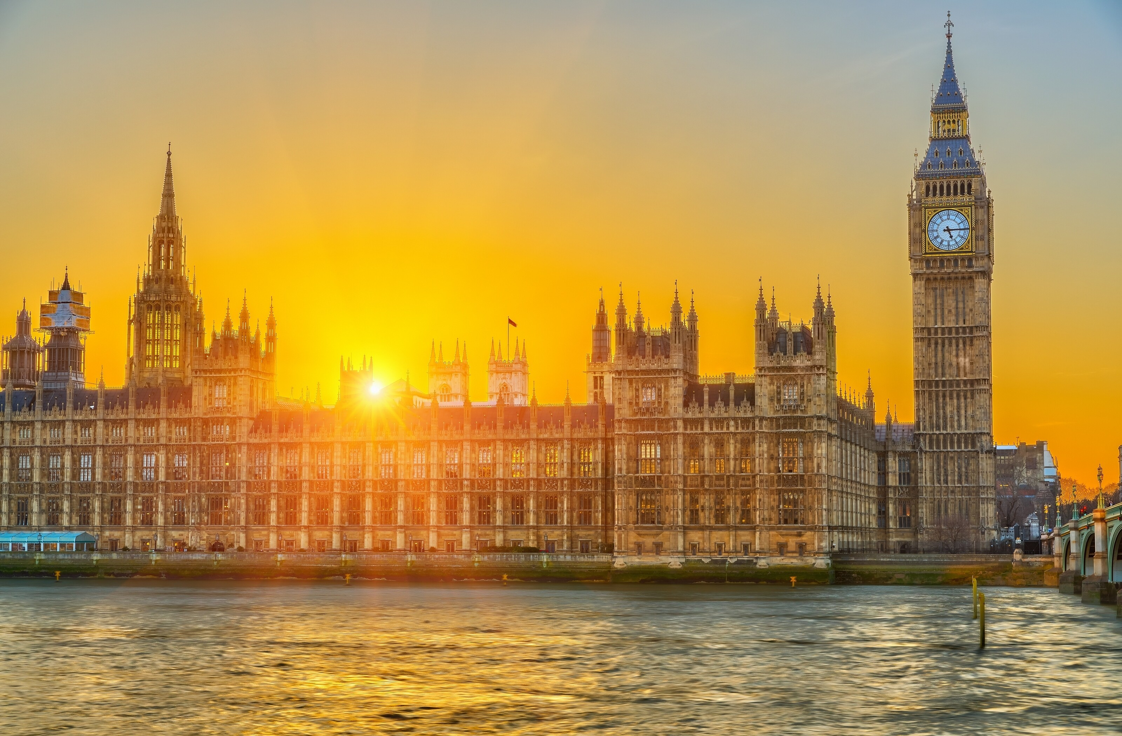
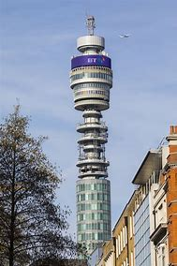
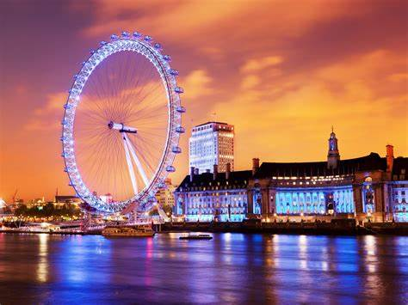


64th fitce congress
18th - 19th September 2025
London, UK

Slide 2
Congress theme
“Terrestrial and Non-Terrestrial Networks Integration”

Slide 3
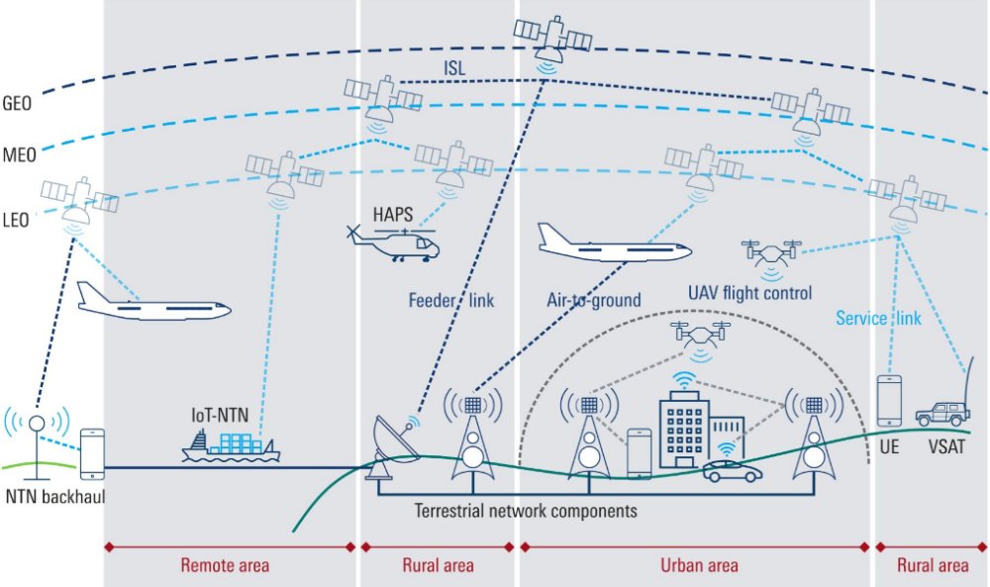
Technical programme will address the developments in the wide range of non-terrestrial networks, their linkage to 5G cellular & other terrestrial networks, and direct to handsets.

Slide 4
Congress Features
Location of Venue
Bloomsbury, Central London
Full Technical Programme
Invited guest speakers;
Broad-based call for presentations/papers = satellite and cellular technology developments,
networking, architectures, commercial, regulatory and service issues;
Papers will be considered for publication in the ITP Journal;
Round table discussions
Full Social Programme
Lunches
Gala dinner
Accompanying person’s programme

Slide 5
Outline Programme
Pre- Congress (17th Sep) | Day One (18th Sep) | Day Two (19th Sep)
 | Registration | Registration
 | Opening Session Welcome Guest Keynotes | Technical Session 3
 | Coffee beak | Coffee break
 | Technical Session 1 | Technical Session 4
Lunch | Lunch | Lunch
BD meeting | Technical Session 2 | Wind-up session
Congress reception |  | FITCE GA
 | Gala Dinner

Slide 6
The ITP Presents:
The 64th FITCE Congress
and
Conference on Terrestrial and Non-Terrestrial Networks Integration
18th-19th September 2025
London

